Slide 1

Solving linear system
Matrix norm and condition number
不正经讲师：理科宅Hunt

Slide 2

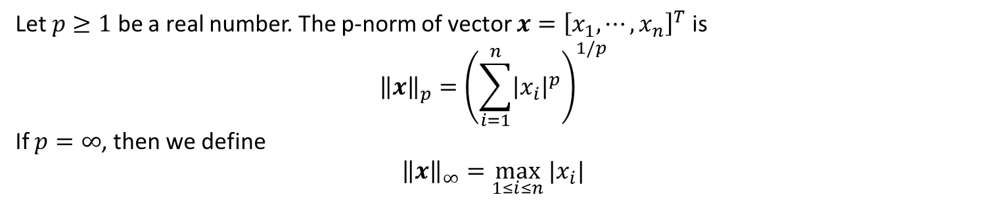
Vector norms
Let $p≥1$ be a real number. The p-norm of vector $x={\left[x_{1},⋯,x_{n}\right]}^{T}$ is
$${\left\|x\right\|}_{p}={\left(\sum_{i=1}^{n}{{\left|x_{i}\right|}^{p}}\right)}^{1/p}$$
If $p=∞$, then we define
$${\left\|x\right\|}_{∞}=\max_{1≤i≤n}{|x_{i}|}$$
Here are two examples we commonly see:
$${\left\|x\right\|}_{1}=\sum_{i=1}^{n}{|x_{i}|}$$
$${\left\|x\right\|}_{2}={\left(\sum_{i=1}^{n}{{\left|x_{i}\right|}^{2}}\right)}^{1/2}$$

Slide 3
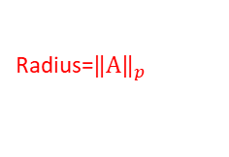

Matrix norm
Def: The p-norm of $n×n$ matrix $A$ is defined as
$${\left\|A\right\|}_{p}=\max_{x≠0} \frac{{\left\|Ax\right\|}_{p}}{{\left\|x\right\|}_{p}}=\max_{{\left\|x\right\|}_{p}=1}{{\left\|Ax\right\|}_{p}}$$
Radius=$‖{\left.A​\right\|}_{p}$
Radius=1

Slide 4
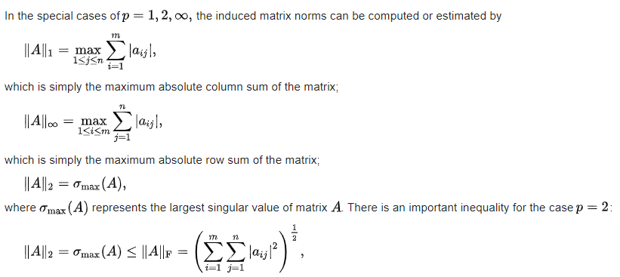
Special cases

Slide 5

Example
Find 1-norm, $∞$-norm, 2-norm of matrix
$$A=\left[\begin{matrix}0 & 1 \\ −2 & 3\end{matrix}\right]$$

Slide 6

Condition number and error
Def: Condition number of a matrix $A$ is denoted as $κ(A)$
Theorem: Relative error in the result is proportional to $κ(A)$.
误差只跟矩阵$A$有关。
我算得不好怎么想都是题目的错！
From previous slides

Slide 7

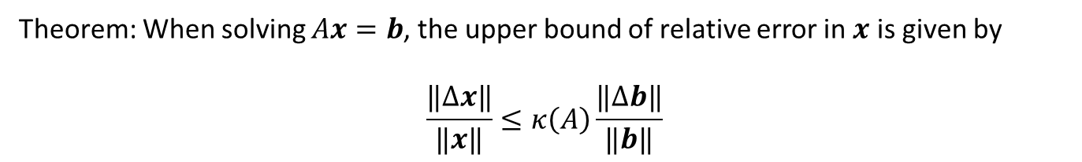
Condition number and error
Def: The condition number of $A$ with respect to norm $‖⋅‖$ is defined as
$$κ\left(A\right)=\left\|A\right\| ‖A^{−1}‖$$
Theorem: When solving $Ax=b$, the upper bound of relative error in $x$ is given by
$$\frac{‖Δx‖}{‖x‖}≤κ\left(A\right)\frac{‖Δb‖}{‖b‖}$$

Slide 8
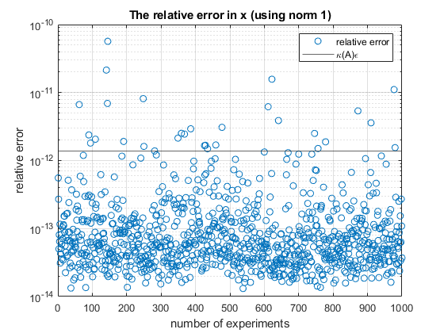
Example
Randomly generate 1000 $100×100$ random matrices and solve equations $Ax=b$. Where $b=Ax_{exact}$.

Slide 9
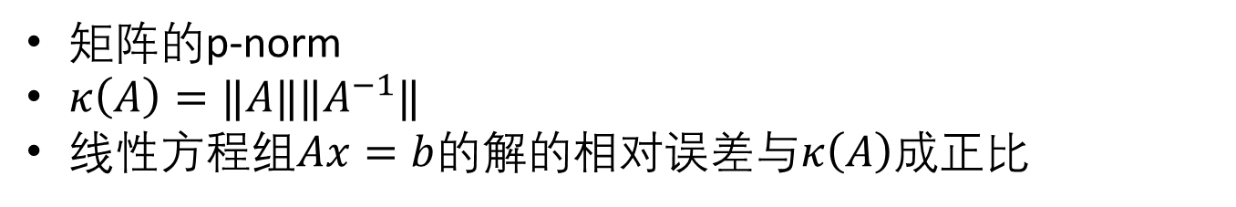
Conclusion – 总结
矩阵的p-norm
$κ\left(A\right)=‖A‖‖A^{−1}‖$
线性方程组$Ax=b$的解的相对误差与$κ\left(A\right)$成正比

